Slide 1
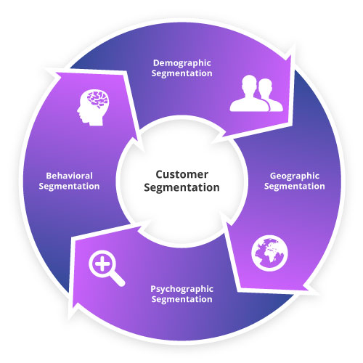
CUSTOMER SEGMENTATION

Slide 2
OUTLINE
TITLE
OUTLINE
INTRODUCTION-CUSTOMER SEGMENTATION
TYPES OF CUSTOMER SEGMENTATION
BENEFITS OF CUSTOMER SEGMENTATION
METHODS OF SEGMENTATION
K-MEANS CLUSTERING
MODEL DEVELOPMENT: K-MEANS CLUSTER
VISUALIZING THE CLUSTER
CLUSTER INTERPRETATION
REAL-CASE USES OF CUSTOMER SEGMENTATION
CONCLUSION
GROUP 2 MEMBERS

Slide 3
CUSTOMER SEGMENTATION
Customer segmentation is the process of dividing a larger customer base into smaller groups based on shared characteristics or behaviours. The goal of customer segmentation is to better understand and target specific customer groups with tailored marketing messages, products, and services that will resonate with them and hence improve customer experience.

Slide 4
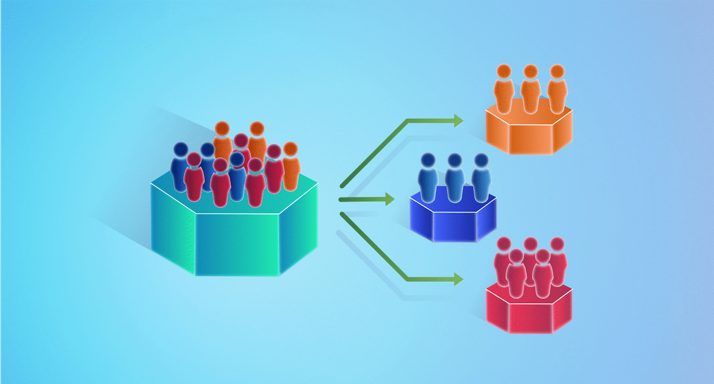

Slide 5
TYPES OF CUSTOMER SEGMENTATION
Demographic segmentation: This involves segmenting customers based on demographic factors such as age, gender, income, education level, marital status, and occupation.
Geographic segmentation: This involves segmenting customers based on their location, such as country, region, city, or zip code.
Psychographic segmentation: This involves segmenting customers based on their personality traits, values, attitudes, interests, and lifestyles.
Behavioural segmentation: This involves segmenting customers based on their behaviour, such as purchase history, frequency of visits or engagement, loyalty, and customer preferences.
Firmographic segmentation: This type of segmentation is mainly used in B2B marketing and involves segmenting customers based on firmographics such as company size, industry, and revenue.
Occasion-based segmentation: This involves segmenting customers based on their behaviour during specific occasions or events, such as holidays, birthdays, or anniversaries.
Benefit-based segmentation: This involves segmenting customers based on the benefits they are seeking from a product or service, such as convenience, quality, or price.

Slide 6
BENEFITS OF CUSTOMER SEGMENTATION
Improved customer experience: By segmenting customers, businesses can tailor their marketing messages and offers to the unique needs and preferences of each customer segment, resulting in a more personalized and relevant experience.
Increased customer retention: When customers feel that a business understands and values their needs, they are more likely to remain loyal to the brand over time.
Higher customer lifetime value: By understanding the specific needs and preferences of each customer segment, businesses can develop more targeted products and services that are likely to generate repeat purchases and increase customer lifetime value.
Better resource allocation: Customer segmentation helps businesses to identify the most profitable customer segments, enabling them to allocate their resources more effectively towards these segments and optimize their return on investment.
Improved marketing efficiency: By targeting specific customer segments with tailored marketing messages and offers, businesses can improve the efficiency of their marketing campaigns, resulting in higher conversion rates and lower marketing costs.
Competitive advantage: By developing a deep understanding of their customers through segmentation, businesses can gain a competitive advantage over their rivals by delivering more personalized products and services and creating a stronger brand reputation.

Slide 7
METHODS OF SEGMENTATION
Traditional methods for customer segmentation: These methods includes conducting surveys, organizing focus groups, analysing customer databases, examining sales data, and evaluating geographic data. While these traditional methods can still be effective in small business, they are often less accurate and less efficient than modern data-driven approaches.
The Machine Learning Method: Involves the use of a machine learning algorithm i.e. clustering algorithms to segment customers into clusters or groups. Clustering algorithms are a type of unsupervised machine learning technique that groups together similar data points based on their characteristics. In customer segmentation, clustering algorithms can be used to group customers together based on similarities in their behavior, preferences, demographics, and other relevant factors.

Slide 8
K-MEANS CLUSTERING
K-means clustering is a popular unsupervised machine learning algorithm used for clustering similar data points into a specified number of clusters. The algorithm aims to partition n observations into k clusters in which each observation belongs to the cluster with the nearest mean (centroid).
The K-means algorithm works by randomly selecting k centroids (representative points for each cluster), and then iteratively optimizing the centroids' positions based on the distances between data points and centroids. The algorithm repeats the following two steps until convergence:
Assign each data point to the closest centroid based on the Euclidean distance between the data point and the centroid.
Update the centroids by computing the mean of all data points assigned to each centroid.

Slide 9
MODEL DEVELOPMENT
Problem Definition: Given the bank customer's data, the goal is to perform customer segmentation to identify different groups of customers with similar characteristics. This can help the bank to understand the customer's behaviour, preferences, and needs, and tailor their marketing strategies, loans and other product offerings to specific customer groups.

Slide 10
MODEL DEVELOPMENT CONT.
Data Collection and Preprocessing: The data used for this project is a publicly available data from Kaggle. The dataset is first cleaned followed by a feature engineering process which includes categorizing the job ranks and education levels, dropping unnecessary columns, and converting categorical variables into dummy variables. Then, it scales the data using either StandardScaler or MinMaxScaler. Next, it uses the Elbow method to determine the optimal number of clusters for K-means clustering, which is found to be 7. It then fits the K-means model to the data and assigns a cluster label to each data point.
Algorithm: K-means clustering algorithm was used for customer segmentation
Visualizing the Cluster: The code also visualizes the clusters using a radar plot that shows the normalized values of different attributes for each cluster, as well as a countplot that shows the distribution of data points across the clusters.
Deployment: The FastAPI framework was used in the deployment stage to interact with the model

Slide 11
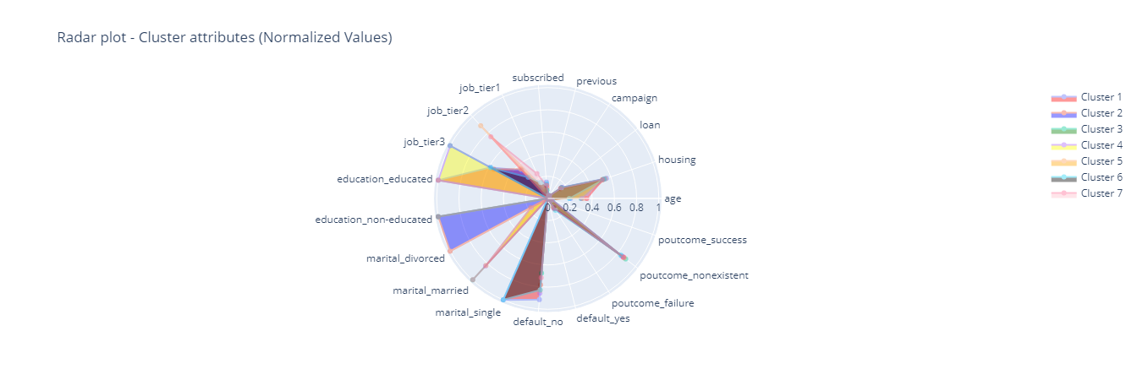
VISUALIZING THE CLUSTER

Slide 12
CLUSTER INTERPRETATION
Cluster1: Shows a large category of young, educated, but mostly single individuals having tier3 jobs. A large number have not had any loan defaults, few have housing loans and the outreach campaign is relatively nonexistent.
Cluster2: Details more of married, non-educated individuals with tier2 jobs with a few having house loans. Cluster2 has a higher number of older customers.
Cluster3: A cluster of mostly single non-educated customers. Most have not defaulted from their loans
Cluster4: Reveals an odd category; married non-educated customers with tier3 jobs and housing loans.
Cluster5: Details a very large number of married educated customers with tier3 jobs. Most are average in age and have housing loans.
Cluster6: Indicates a number of educated customers, some married and some single. They have tier2 jobs and a number have housing loans
Cluster7: A little bit similar to cluster 5 except there is a lesser number of customers with loans.

Slide 13
REAL-CASE USES OF CUSTOMER SEGMENTATION
Companies have started to discover the importance of using ML in clustering their customers in increasing profits. The list below shows just a few examples of companies using machine learning in customer segmentation:
FIRST BANK: First Bank is one of the oldest and largest banks in Nigeria, and the bank uses customer segmentation to better understand and serve its customers. First Bank has identified different customer segments, including personal banking customers, SME banking customers, and corporate banking customers.
GTBANK: Guaranty Trust Bank is a leading Nigerian bank that uses customer segmentation to create tailored products and services for different customer segments. The bank has identified four customer segments, including retail banking customers, SME banking customers, corporate banking customers, and e-banking customers.
MTN: This telecommunication company has made clusters of their customers based on certain habits. What services are used and how much they spend on those services are the important information by which they create the clusters.
NORTH FACE: A reputable fashion brand has partitioned their customers based on different lifestyle segments like, “explorer”, “traveler”, “hiker”, “extreme athlete”, there are still a lot more segments. With the information about the different segments relevant products are then push to each segment.
BOLT: One of the world’s largest ride-hailing companies, they have learnt to classify their customers based on riding history. With the clusters they have determined individuals who frequently request rides and those that do not. They are able to easily target promos and discounts to their customers

Slide 14
CONCLUSION
Through the use of machine learning we have demonstrated how effectively machine learning can greatly benefit the financial sector. Given the bank customer's data, our K-means model was able to partition the customers into different groups of individuals with similar characteristics. This can help the banks and other companies to understand customer's behaviour, preferences, and needs, and tailor their marketing strategies, loans and other product offerings to specific customer groups.

Slide 15
GROUP 2 MEMBERS
MARYANN NNAJI
CHUKWUNENYE ANENE
ADEDARA ADELORO
SULE MUHAMMED ABBA

Slide 16
THANK YOU

